Slide 2
Dotted = ice-off
Dashed= ice-on

Slide 4
Notes:
Lindavia increases in winter, holds steady in summer

Slide 5
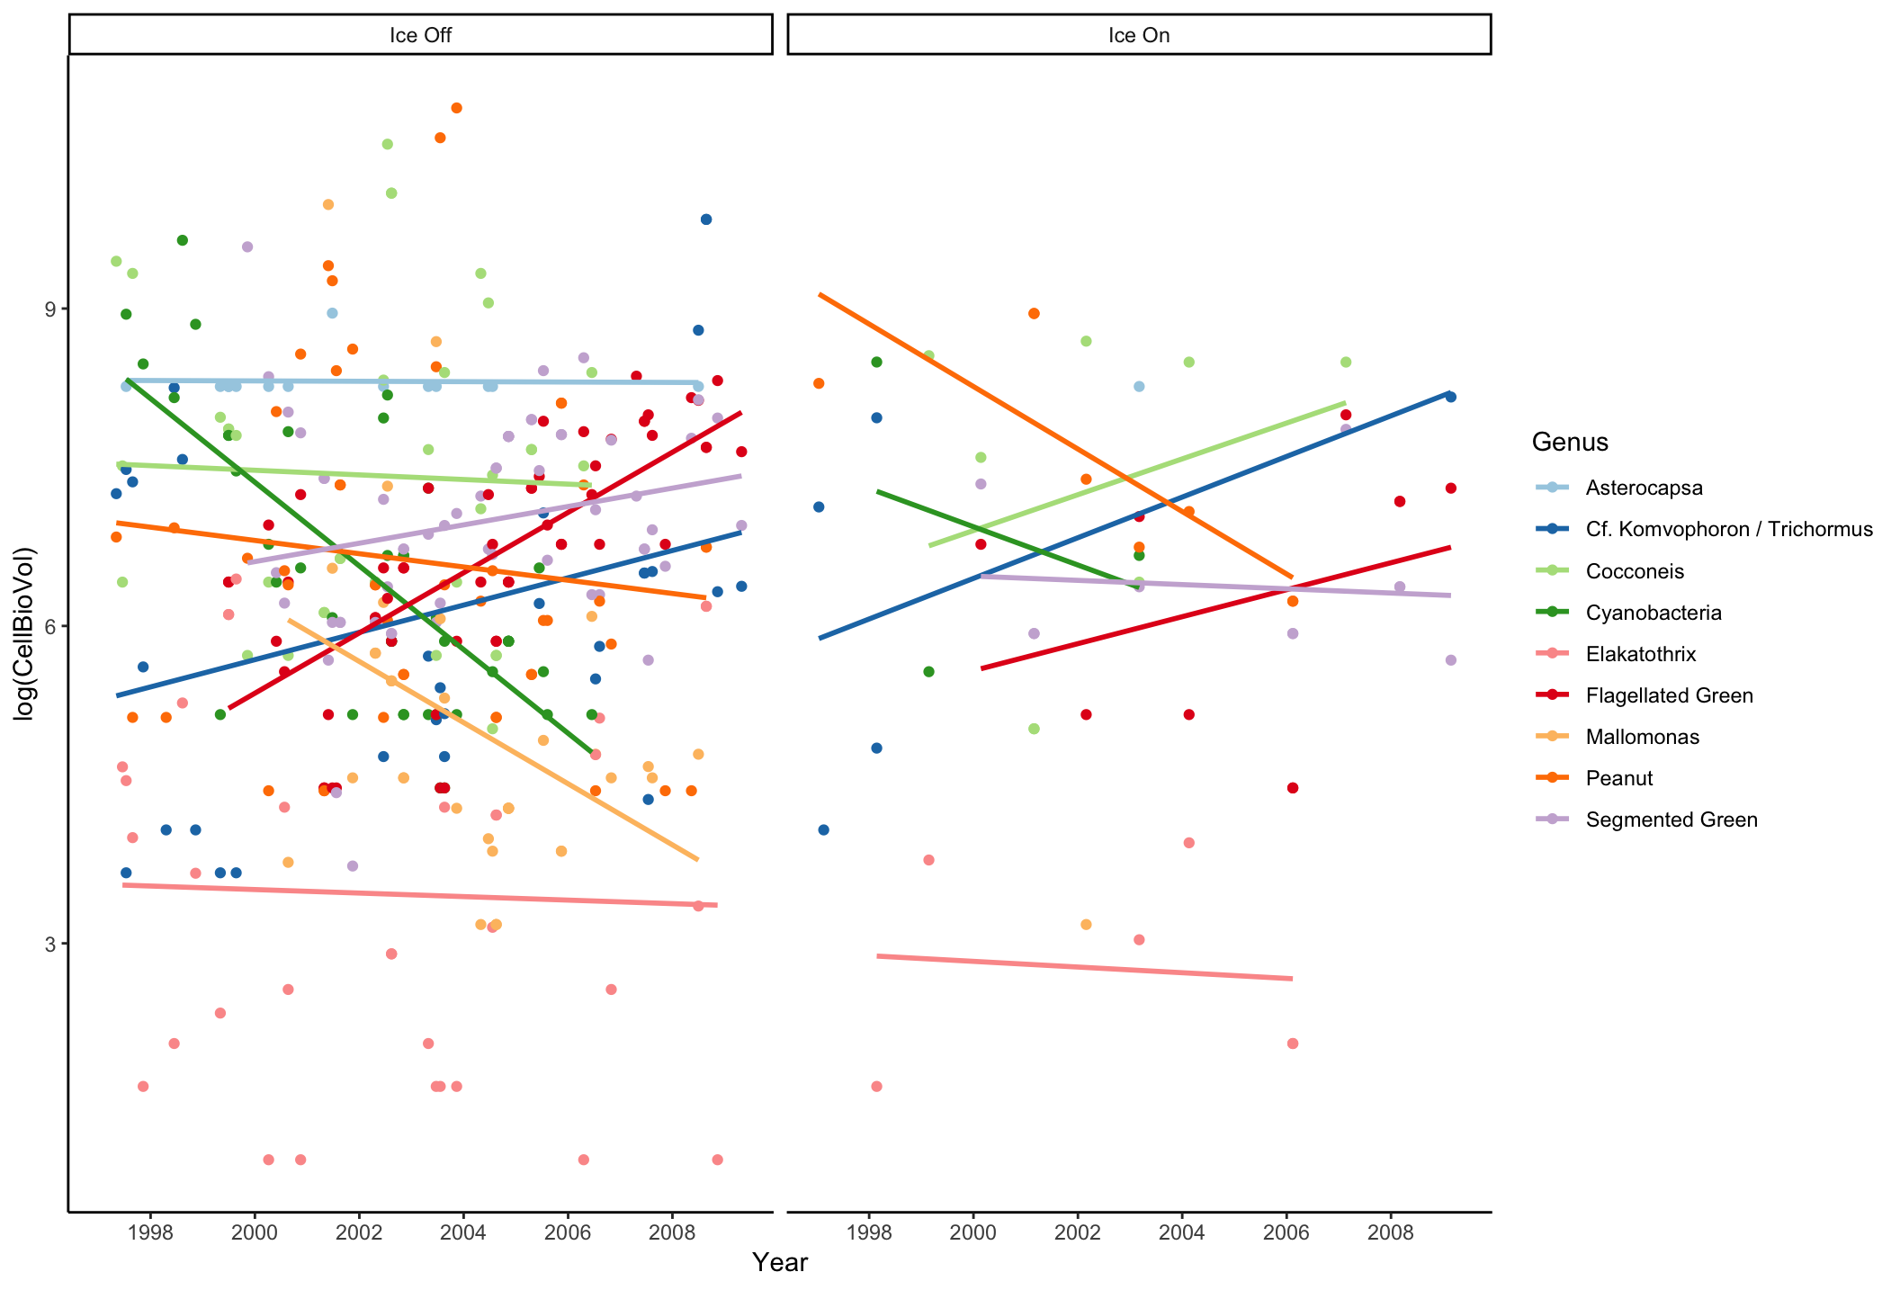
Notes:
Peanut slight decline in summer larger in winter, mallomonas sharp decrease, Asterocapsa only present in summer, Cf K/T increase in both conditions, cocconeis increase with ice while steady with no ice, cyanos decline in both conditions (less prominate in winter),

